Slide 1


V.VIGNESHWARAN
Final Project
3/21/2024 Annual Review
1

Slide 2


Message app using steganography
3/21/2024 Annual Review
1

Slide 3



AGENDA
Problem overview (Should not include solution)
Who are the end users
Proposed Solution
System Development Approach (Technology Used)
Algorithm & Deployment
Modelling
Result (Output Image)
Conclusion
Future Scope
References
3/21/2024 Annual Review
3

Slide 4

PROBLEM STATEMENT
In today's digital age, maintaining the privacy and confidentiality of online communication has become increasingly challenging. Traditional messaging platforms often lack robust security measures, leaving users vulnerable to interception, surveillance, and data breaches. Furthermore, even encrypted messaging services can be susceptible to metadata analysis, compromising user anonymity.
To address these concerns, there is a need for a secure communication platform that goes beyond conventional encryption methods. The solution should provide end-to-end encryption while also incorporating steganography techniques to conceal the very existence of sensitive communications. By embedding messages within innocuous digital assets such as images, audio files, or text, users can communicate covertly without drawing unwanted attention or suspicion.
3/21/2024 Annual Review
4

Slide 5

PROJECT OVERVIEW
StealthChat is a revolutionary messaging app that prioritizes security and privacy through steganography. By embedding messages within innocuous digital files like images and audio clips, StealthChat ensures covert communication that's nearly impossible to detect by unauthorized parties.
Key Features:
Secure Communication: Advanced encryption techniques protect messages, ensuring they remain unreadable to anyone other than the intended recipient.
Covert Messaging: Messages are hidden within everyday digital media, adding an extra layer of security by making detection difficult for eavesdroppers.
Flexible Steganography Techniques: Users can select from various steganography methods, tailoring security levels to their preferences.
Seamless Integration: StealthChat seamlessly incorporates steganography into messaging, making secure communication accessible and user-friendly.
Cross-Platform Compatibility: Users can securely communicate across different devices and platforms without sacrificing convenience.
3/21/2024 Annual Review
4

Slide 6

WHO ARE THE END USERS?
This app is not for global communication, it can be used in a local area network.
3/21/2024 Annual Review
4

Slide 7

YOUR SOLUTION AND ITS VALUE PROPOSITION
To address these challenges, we propose the development of a steganography-based chat application. Unlike traditional messaging platforms, which rely solely on encryption to protect message content, our solution leverages steganographic techniques to conceal the very existence of sensitive communications.
Steganography, the art of hiding information within other data, offers a unique approach to secure communication by embedding messages within innocuous digital assets such as images, audio files, or text. By doing so, the chat application can facilitate covert communication without drawing unwanted attention or suspicion.
3/21/2024 Annual Review
4

Slide 8

THE WOW IN YOUR SOLUTION
no other user than the actual recevier can identify the message in the image.
useful for secure message transfer in a LAN
3/21/2024 Annual Review
10

Slide 9

MODELLING
RSA Is an asymmetric Encryption algorithm in which each participant has both a public
and a private key. To use RSA for confidentiality, we wanted to encrypt each message
by the receiver’s public key so only they can decrypt and read the content of the
message using their private key. However, doing that directly with the RSA would
require a very large key size or else the plain text would be too large to be encrypted by
the algorithm but using large keys would cause huge delay between sending and
receiving each message. A possible solution was to use the RSA to encrypt a session
key generated by another symmetric algorithm. We tried using AES to encrypt
messages and decrypt the AES session key itself using RSA, however, that would be a
huge overhead as we would need to implement sessions between the clients and
handle cases when session key changes.
The first library that we tried to use for the RSA was PyCrypto. However, we realized
that it was outdated so we moved to another fork of the repo which is PyCryptodomex.
We used AES, PKCS1_OAEP and RSA.
To generate a session key, we used Cryptodome.Random.get_random_bytes.
Functions:
RSA.generate: creates a new RSA key object.
Crypto.Cipher.PKCS1_OAEP.new: takes an RSA key object an creates a cipher
object that is used to perform PKCS#1 OAEP encryption or decryption.
PKCS1OAEP_Cipher.encrypt: encrypts a byte string message whose length is not
longer than the RSA modulus (in bytes) minus 2, minus twice the hash output size.
AES.new: Creates a new AES cipher.
encrypt_and_digest: ِEncrypts a message using AES.
PKCS1OAEP_Cipher.decrypt: decrypts a message using RSA.
Decrypt_and_verify: decrypts a message using AES.
3/21/2024 Annual Review
10

Slide 10
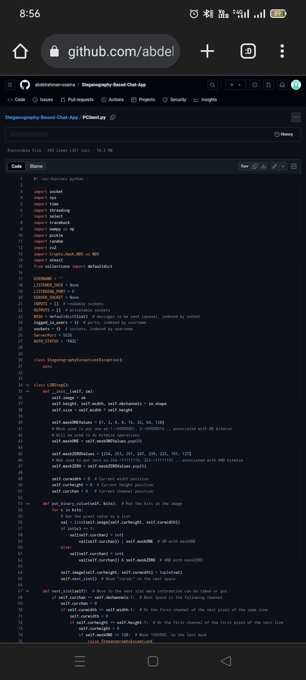
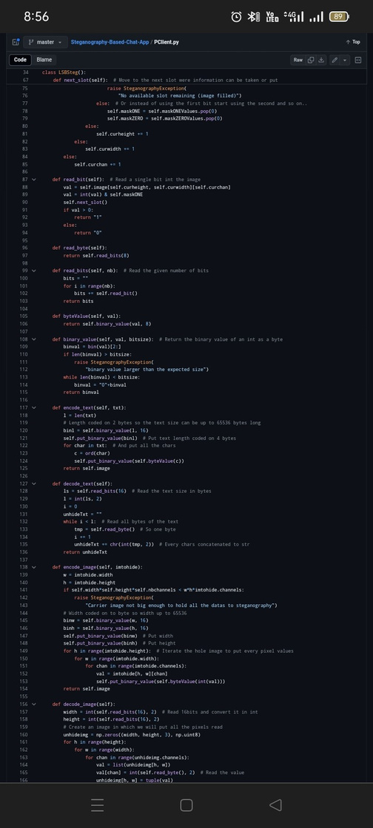
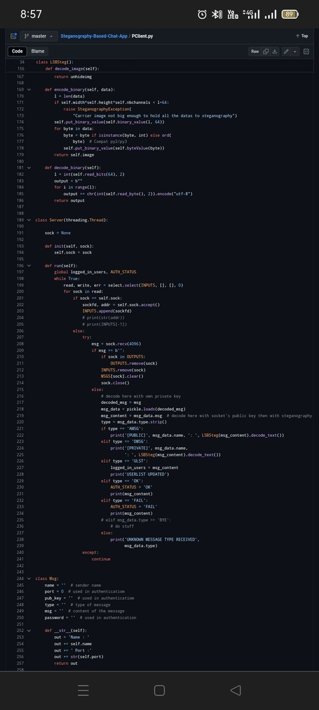
Algorithm
Demo Link
3/21/2024 Annual Review
10

Slide 11
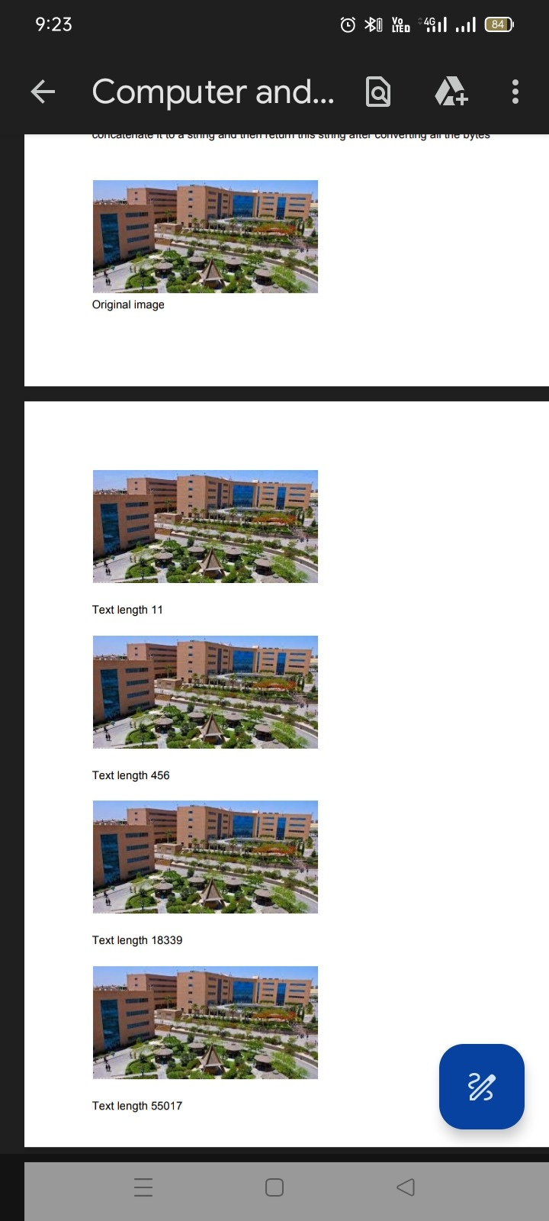
RESULTS
encode_text
The function takes the text string as an input
The algorithm calculates the length of the string
This Length is coded on 2 bytes so the text size can be up to 65536 bytes long, the
function takes an int as input and return the binary value of it as a byte
The output of the above function is then passed to another function to Put text length
coded on 4 bytes into the image by getting the pixel value as a list, and loop over the
input bits one by one and checks if the bit is equal to 1 then the corresponding element
in the list to the current channel will be equal to the value of that element bitwise ANDed
with the maskOne value or ORed with the maskZero value and then move to the next
slot and start over
All pixels of the image are scanned to select a pixel having a remainder of 1 when each
RGB value is divided by eight. Change the color of the selected pixel so that there is no
more than one.
After that, The algorithm gets the Unicode code point for a one-character string for each
character in the text and use this unicode and get the binary value of it as a byte then
puts this byte in the image using the same technique
decode_text
The function reads the bits in the 2 bytes specified on by one
It gets the value of the image at the current width, height and channel, convert it to int,
then and it with the maskOne value and return 1 if the value is larger than 0 and 0
otherwise
The value then is converted to binary number, this bits are used to get all the bytes of
the text
For each byte read, the algorithm gets the Unicode string with ordinal and then
concatenate it to a string and then return this string after converting all the bytes
Demo Link
3/21/2024 Annual Review
10

Slide 12
conclusion
In conclusion, the development of a steganography-based chat app using Python offers a robust solution for secure communication. By integrating steganographic techniques into the app, users can conceal their messages within innocuous images, ensuring privacy and confidentiality. This project not only demonstrates the practical implementation of steganography but also underscores the importance of encryption in modern communication systems. As technology advances, integrating such secure communication methods becomes increasingly vital in safeguarding sensitive information from unauthorized access.
Demo Link
3/21/2024 Annual Review
10

Slide 13
future scope
Looking ahead, there are several promising avenues for further enhancing the steganography-based chat app developed in Python. One potential direction is the integration of more advanced steganographic techniques to increase the capacity and robustness of message concealment. Additionally, exploring the incorporation of encryption algorithms alongside steganography could offer an even higher level of security for communication.
Furthermore, expanding the app to support multimedia formats beyond images, such as audio and video files, would broaden its utility and appeal to users. Implementing features like real-time messaging, group chats, and file sharing capabilities could also enrich the user experience and make the app more versatile.
Moreover, considering the rapid evolution of technology and the increasing demand for privacy in digital communication, continued research and development in this area could lead to innovative solutions and advancements in secure messaging systems. Exploring compatibility with emerging platforms and technologies, such as blockchain and decentralized networks, could further enhance the app's resilience to potential threats and ensure its relevance in the ever-changing landscape of digital communication.
Demo Link
3/21/2024 Annual Review
10

Slide 14
Reference
N. F. Johnson and S. Jajodia, "Exploring steganography: Seeing the unseen," in Computer, vol. 31, no. 2, pp. 26-34, Feb. 1998.
https://realpython.com/python-sockets/
Demo Link
3/21/2024 Annual Review
10

